Slide 1
WIAI CAREER CENTER
01110111 01101001 01100001 01101001 00100000 01100010 01100001 01101101 01100010 01100101 01110010 01100111 00100000 01110010 01101111 01100011 01101011 01110011 00100000 01101001 01101110 01110100 01100101 01110010 01100100 01101001 01110011 01111010 01101001 01110000 01101100 01101001 01101110 11000011 10100100 01110010 00100000 01101001 01101110 01110100 01100101 01110010 01101110 01100001 01110100 01101001 01101111 01101110 01100001 01101100 00100000 01110000 01100101 01110010 01110011 11000011 10110110 01101110 01101100 01101001 01100011 01101000 01110111 01101001 01100001 01101001 00100000 01100010 01100001 01101101 01100010 01100101 01110010 01100111 00100000 01110010 01101111 01100011 01101011 01110011 00100000 01101001 01101110 01110100 01100101 01110010 01100100 01101001 01110011 01111010 01101001 01110000 01101100 01101001 01101110 11000011 10100100 01110010 00100000 01101001 01101110 01110100 01100101 01110010 01101110 01100001 01110100 01101001 01101111 01101110 01100001 01101100 00100000 01110000 01100101 01110010 01110011 11000011 10110110 01101110 01101100 01101001 01100011 01101000 01110111 01101001 01100001 01101001 00100000 01100010 01100001 01101101 01100010 01100101 01110010 01100111 00100000 01110010 01101111 01100011 01101011 01110011 00100000 01101001 01101110 01110100 01100101 01110010 01100100 01101001 01110011 01111010 01101001 01110000 01101100 01101001 01101110 11000011 10100100 01110010 00100000 01101001 01101110 01110100 01100101 01110010 01101110 01100001 01110100 01101001 01101111 01101110 01100001 01101100 00100000 01110000 01100101 01110010 01110011 11000011 10110110 01101110 01101100 01101001 01100011 01101000 01110111 01101001 01100001 01101001 00100000 01100010 01100001 01101101 01100010 01100101 01110010 01100111 00100000 01110010 01101111 01100011 01101011 01110011 00100000 01101001 01101110 01110100 01100101 01110010 01100100 01101001 01110011 01111010 01101001 01110000 01101100 01101001 01101110 11000011 10100100 01110010 00100000 01101001 01101110 01110100 01100101 01110010 01101110 01100001 01110100 01101001 01101111 01101110 01100001 01101100 00100000 01110000 01100101 01110010 01110011 11000011 10110110 01101110 01101100 01101001 01100011 01101000 01110111 01101001 01100001 01101001 00100000 01100010 01100001 01101101 01100010 01100101 01110010 01100111 00100000 01110010 01101111 01100011 01101011 01110011 00100000 01101001 01101110 01110100 01100101 01110010 01100100 01101001 01110011 01111010 01101001 01110000 01101100 01101001 01101110 11000011 10100100 01110010 00100000 01101001 01101110 01110100 01100101 01110010 01101110 01100001 01110100 01101001 01101111 01101110 01100001 01101100 00100000 01110000 01100101 01110010 01110011 11000011 10110110 01101110 01101100 01101001 01100011 01101000 01110111 01101001 01100001 01101001 00100000 01100010 01100001 01101101 01100010 01100101 01110010 01100111 00100000 01110010 01101111 01100011 01101011 01110011 00100000 01101001 01101110 01110100 01100101 01110010 01100100 01101001 01110011 01111010 01101001 01110000 01101100 01101001 01101110 11000011 10100100 01110010 00100000 01101001 01101110 01110100 01100101 01110010 01101110 01100001 01110100 01101001 01101111 01101110 01100001 01101100 00100000 01110000 01100101 01110010 01110011 11000011 10110110 01101110 01101100 01101001 01100011 01101000 01110111 01101001 01100001 01101001 00100000 01101100 01101001 01100011 01101000 01110111 01101001 01100001 01101001 00100000 01100010 01100001 01101101 01100010

Slide 2
WIAI Career Center
WIAI is the only faculty at the University of Bamberg that offers a career service to its students.
Our service* includes, among others:
Job portal Jobbörse WIAI
Yearly career day Karrieretag WIAI
Corporate Internship Program
CV check
*Please notice that not all services are offered during semester breaks.

Slide 3
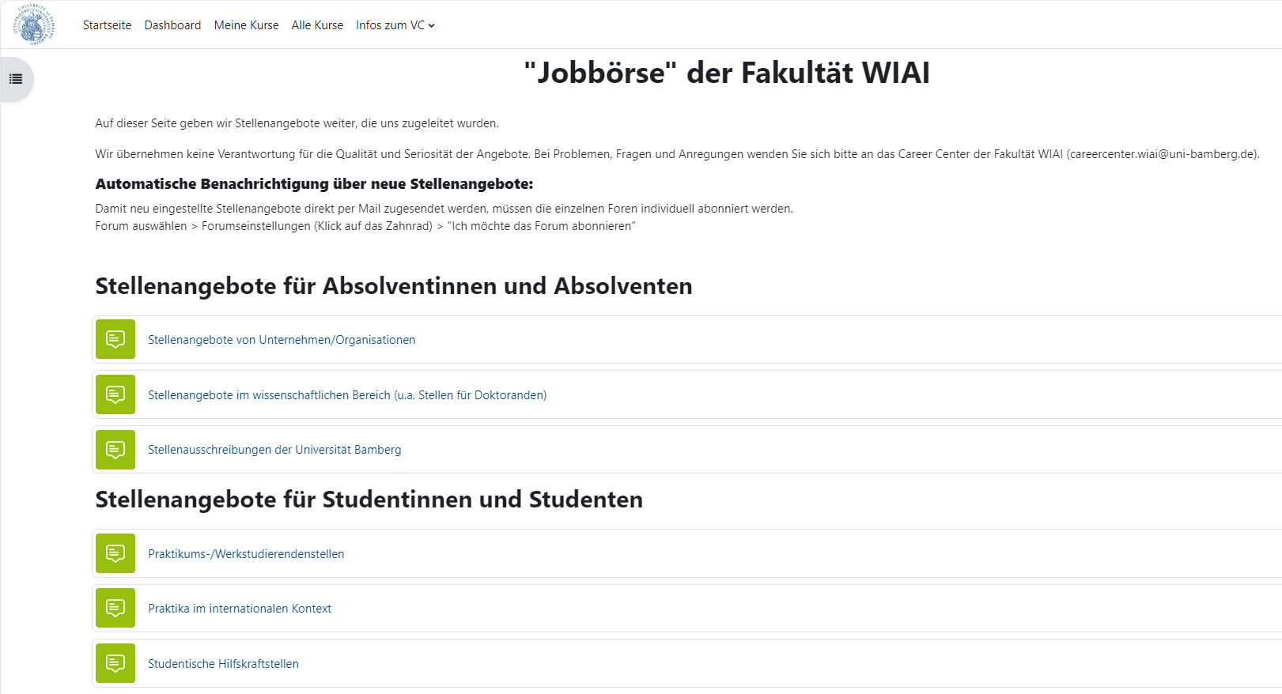
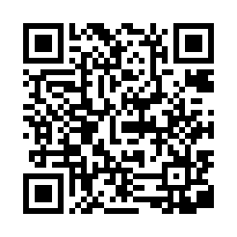
Jobbörse WIAI
Virtual Campus Course that regularly posts:
Internships
Working student jobs
Trainee positions
Regular job offers
Industrial career events
Events of the WIAI faculty
Your advantage:
Jobs and events posted in the Jobbörse WIAI are sent
to us by selected companies that explicitely look for
WIAI students!
SIGN IN!

Slide 4
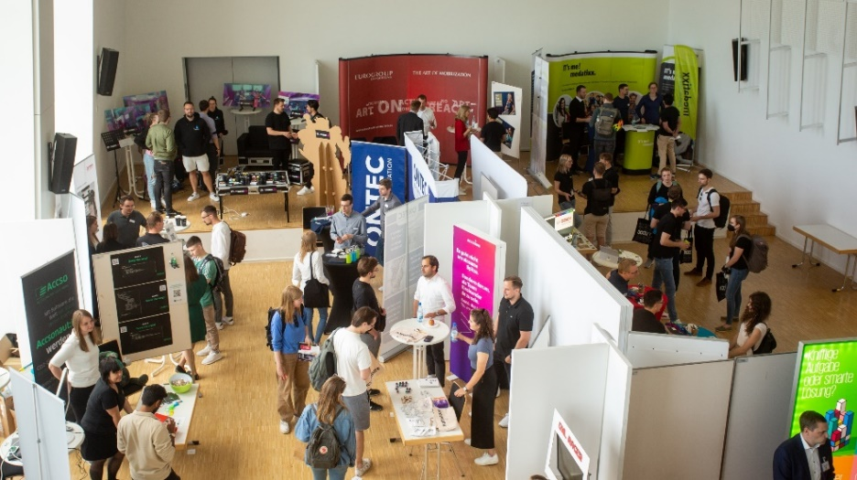
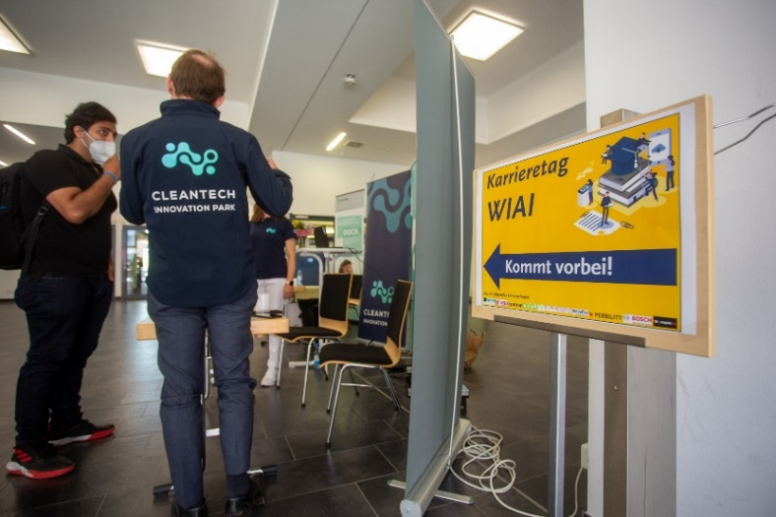
Karrieretag WIAI (May 14, 2024)
In summer semesters the WIAI faculty hosts ist own career day:
Job fair with 20+ regional as well as international companies
Application document checks (e.g. CVs, cover letters)
Application training
Presentations
© Tim Kipphan/Uni Bamberg
© Tim Kipphan/Uni Bamberg

Slide 5






Corporate Internship Program
WIAI students have the opportunity to gain early international practical experience during their studies.
Selected partner companies abroad provide a certain number of internships each year for which WIAI students can apply.

Slide 6
Contact
E-Mail: careercenter.wiai@uni-bamberg.de
Website: https://www.uni-bamberg.de/wiai/career/

