Slide 1

Erstsemestereinführungstage
Winter Semester 2024/2025
8th to 11th October
Information Systems and Applied Computer Sciences Faculty
Notes:
Begrüßung
Vorstellung
Rückblick
Einleitung Dozenten

Slide 2



Welcome Addresses and General Information
Schedule for the Plenary Session
10:30 a.m. – 12:00 p.m.
Prof. Dr. Andreas Henrich, Dean of the Faculty
Prof. Dr. Daniel Beimborn, Dean of Studies
Ines Häuser, WIAI Examination Boards
Laura Folter, Career and International Center
Dr. Sarah Böhlau, Contact point for studies and disabilities
Dr. Katharina Kanitz, Central Student Counseling at Bamberg University
Franziska Paukner, Faculty Women‘s Representative
Theresa Knoll and Laetitia Hilgendorf, student council
(“Fachschaft WIAI“)
08.10.2024
Notes:
Prof. Guido Wirtz, Dekan der Fakultät
übernimmt auch die Präsentation von Prof. Beimborn, dem Studiendekan der WIAI
Tim Kipphan für den Career und den International Center
Ines Häuser für die Prüfungsausschüsse der Fakultät
Franziska vertritt die Fakultätsfrauenbeauftragte Frau Prof. Schmid
Kai Imhof von der zentralen Studienberatung
Zuletzt melden sich Theresa und ich nochmal bei euch und erzählen euch etwas über die Fachschaft

Slide 3



Fachschaft WIAI – The Student Council
Who are we?
students, just like you!
7 elected representatives and a magnificent community of devoted procrastinators
not to forget: Fooboar, our mascot
08.10.2024

Slide 4


Fachschaft WIAI – The Student Council
What do we do?
We welcome new students (aka you) to the faculty.
We provide Mate (and helpful advice) to take on any problems regarding your studies.
We represent your interests in a range of university committees.
We organize a collection of events (Summer Barbecue, Christmas Party, regulars‘ table).
We offer independent workshops (LaTeX/BibTeX, Linux, …).
We provide (more or less) useful services for your studies (suche.wiai.de, …).
Our goal is to make your time in Bamberg as enjoyable as possible.
08.10.2024

Slide 5


Fachschaft WIAI – The Student Council
LaTeX Workshop
weekend seminar about the LaTeX typesetting system
wide-spread in academic writing
our recommendation for all seminar papers
save the date: November 25th and 30th
detailed information can be found on the registration page: wiai.de/latex
08.10.2024

Slide 6
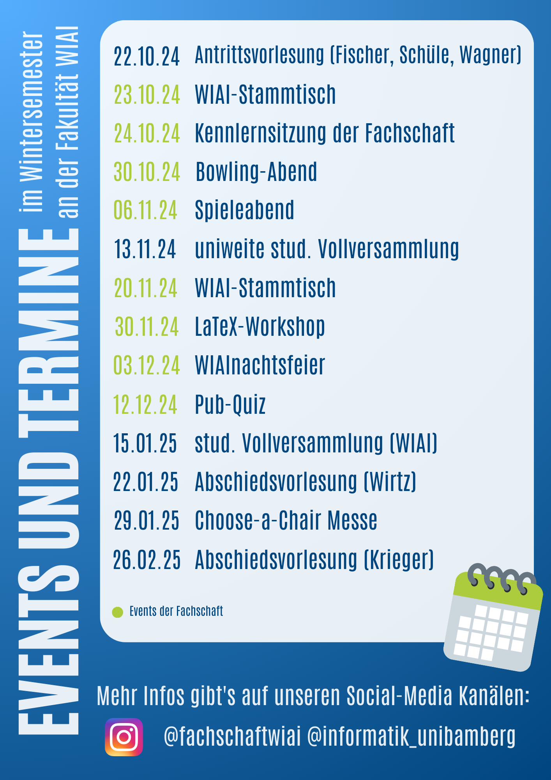



More events this summer
from Fachschaft WIAI, faculty WIAI and many more
even more events
LaTeX-Workshop
Bowling Night
Regulars‘ Table by Fachschaft WIAI
„Choose-a-chair“ Fair
WIAI christmas party
Games Night
and many more!
08.10.2024
Notes:
Kommende Veranstaltungen

Slide 7







Fachschaft WIAI – The Student Council
Where can you find us?
WE5/02.104 (on the second floor, next to the small staircase)
fachschaft-wiai.stuve@uni-bamberg.de
+49 951 863-1219
www.uni-bamberg.de/wiai/fs
@fachschaftwiai
@fachschaftwiai
Join us at our introductory meeting an October 24th, 6:15 p.m. (WE5/02.020)!
We are always looking for fellow procrastinators.
08.10.2024

Slide 8
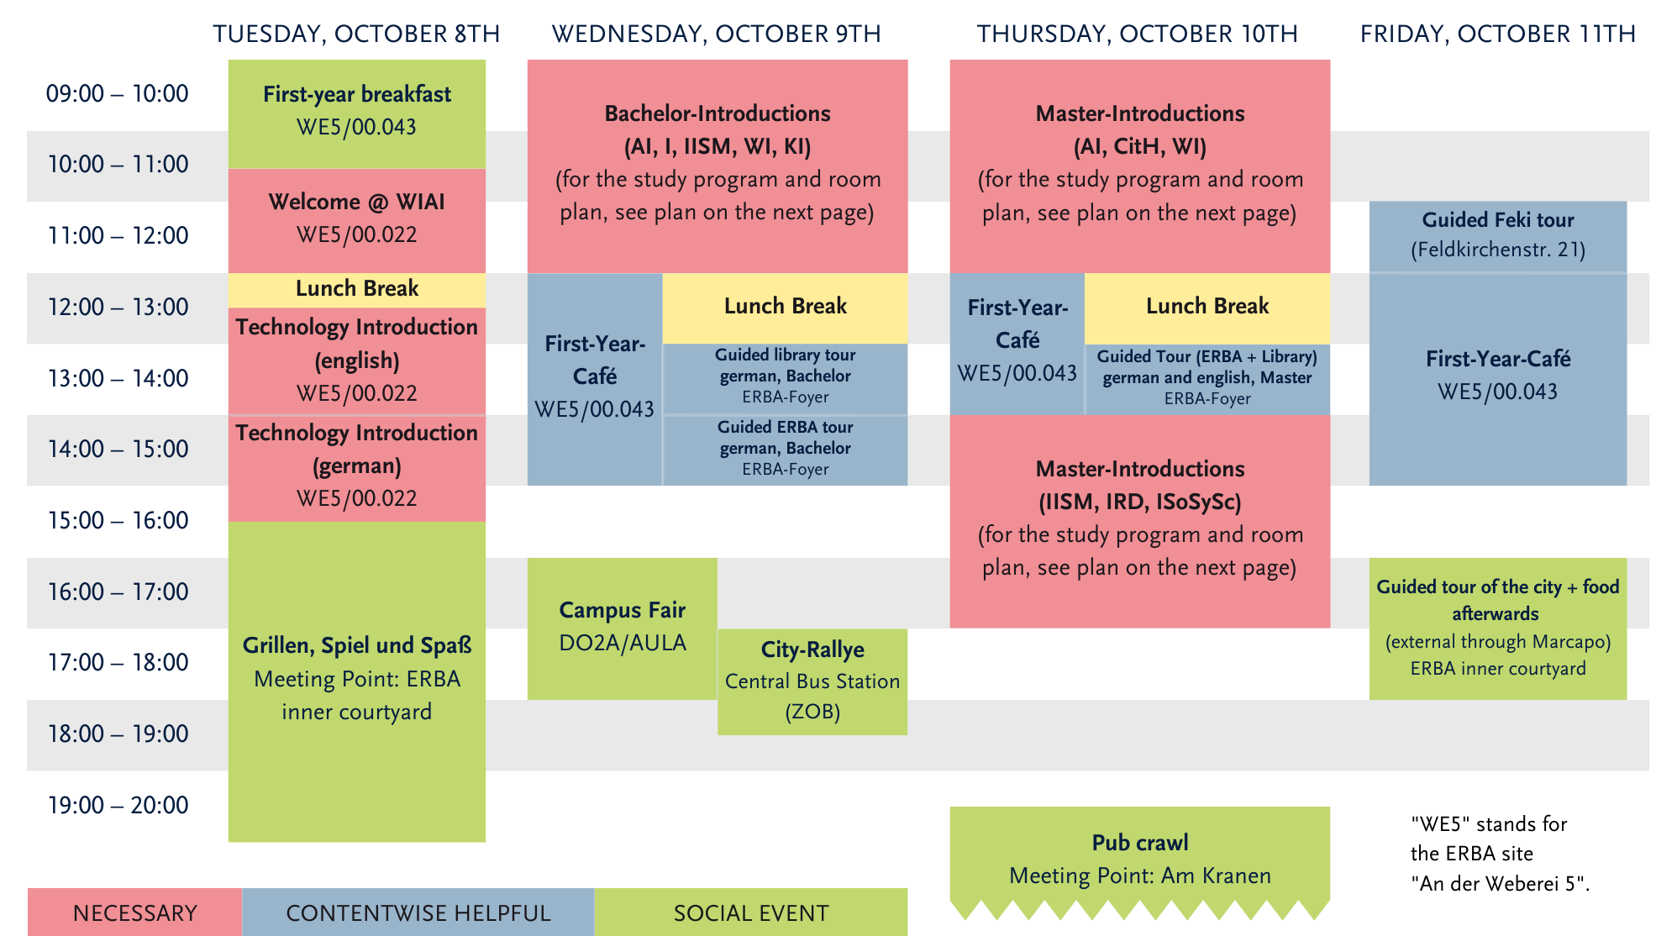
Upcoming events in the next days
from Fachschaft WIAI and other student groups
08.10.2024
Notes:
Kommende Veranstaltungen

Slide 9

Upcoming events in the near future
from Fachschaft WIAI and other student groups
Upcoming events:
Partycipate (Party after „Kneipentour“), 10.10. @ Live-Club
Student Council Introductory Meeting, 24.10., 6:15 p.m. @ WE5/02.020
Bowling Night, 30.10. @ Bowlinghaus Bamberg
WIAI regular‘s table, 23.10.
Regulars‘ table (by feki.de), beginning of the semester @ various bars
‒
08.10.2024
Notes:
Kommende Veranstaltungen

Slide 10
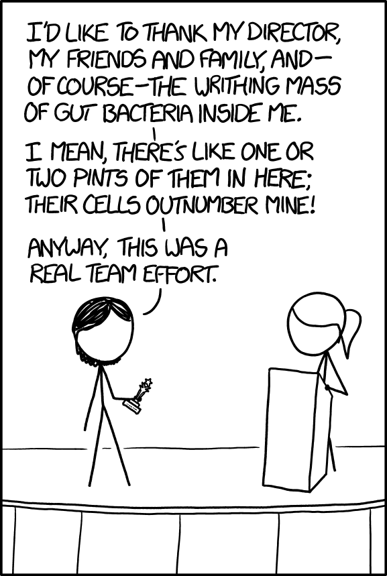
Fachschaft WIAI – The Student Council
Thanks to our tutors and helpers!
Lydia
Laetitia
Theresa
Janne
Florian
Jochen
Tobias
Josi
Katharina Adrian
Sandra
Jessi
Nina
Laura
Noah
Clara
Alice
Tobias
Source: https://xkcd.com/1543/
08.10.2024

